Slide 1


Blockchain for smart grids management
Marco Galici, University of Cagliari Cagliari, Italy
Notes:
Welcome all. Today We are going to speak in deeper about the blockchain.

Slide 2







Course material developed in collaboration with University of Cagliari, University of Cyprus, University of Western Macedonia, Mines ParisTech, Technische Hochschule Ulm, Deloitte, WIP with support from Erasmus+

Slide 3
Content Structure
What is the blockchain?
How does it function?
Which are the basis of the blockchain?
Bitcoin
Consensus Algorithms
Possible attacks on blockchain technology

Slide 4
Blockchain
One of the last novelty that came out of the ICT sector
Due to Bitcoin, the interest in blockchain raised
The last revolution of the ICT sector with potential near to the Internet in 90s
Due to the bitcoin fluctuation in 2018 the interest on this technology went down
However, thanks to the “halving” of bitcoin, Coronavirus etc, the interest is raising again

Slide 5
Everything started with Bitcoins
At the end of 2000, an hacker group and cryptography researchers asked themselves how to build a digital currency without central authority. It needs to be characterized by:
Internet;
public; everyone is accepted;
decentralized. It should function even in presence of attacks and does not require trust from participant;
anonymity;
safety. Each participant has guarantee that there is no possibility of copying it.
equality

Slide 6
Bitcoin
At the end of 2008, Satoshi Nakamoto, false name which represents one person or a group of people currently unknown to the world, started the P2P Bitcoin network.
At the beginning, it was a cryptographic game, but after few times it started to be valorised.
In 12/10/2009, 5050 BTC are equal to 5,02 US$
The day 22/5/2010 Laszlo Hanyecz bought two pizzas from “Papa John’s” for 10.000 BTC (at that time equal to 25 US$).
Today one BTC is changed for 39.118 US$.

Slide 7
But first let us ask ourselves: What is money?
A means of exchange:
To exchange goods beyond simple trade
Official currencies may not be refused by law
One unit of account:
Recognisable, usable, divisible, transferable, difficult to fake
A value reserve:
Stable and durable
Not common
"Concentrated" in little space
Based on confidence that can be spent in the future.

Slide 8
The psychological basis
Until 40-50 years ago, money was only physical: - physical banknotes - gold and silver coins - paper stocks (bonds, shares...) - receipts from bank deposits, bills of exchange...
In recent years, money has become primarily an electronic recording of banking transactions
In case of serious electrical and network problems (war, EMP...) the risk of temporary unavailability or even permanent loss of one’s money is high
Nowadays, people have no problem with the intangible exchange of money

Slide 9
So:
Today money is mainly electronic, or in other words a registration within a database: - Bank accounts - Credit and prepaid cards - Bonds, funds, . . .
Normally, the manager is a bank
Records are very secure: duplicate databases, redundant and distant computing site, backups...
However, in principle, a distributed (and thus replicated) peer-to-peer database could have the same secure record-keeping function!
The common factor in these scenarios is the TRUST!

Slide 10
The mathematical and computer bases
The mathematical (cryptographic) basis of cryptocurrencies are:
asymmetric cryptography
properties of hash functions
The theory of games
The computer bases are:
the Internet network
peer-to-peer architecture
specific data structures for efficient storage and retrieval of information
intensive calculation capacity,

Slide 11
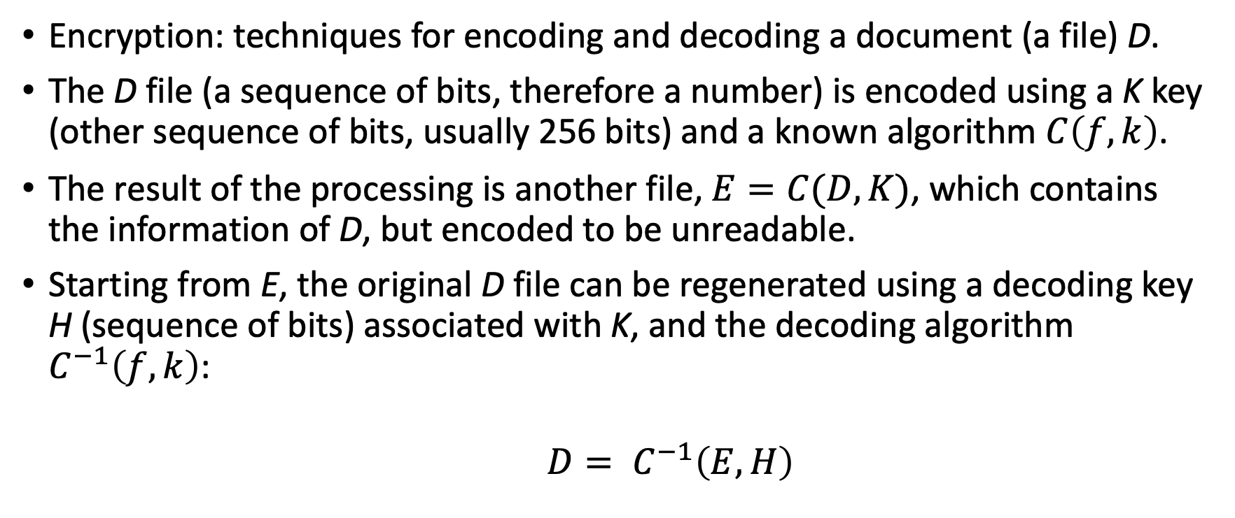
Cryptography
Encryption: techniques for encoding and decoding a document (a file) D.
The D file (a sequence of bits, therefore a number) is encoded using a K key (other sequence of bits, usually 256 bits) and a known algorithm $C\left(f,k\right)$.
The result of the processing is another file, $E=C(D,K)$, which contains the information of D, but encoded to be unreadable.
Starting from E, the original D file can be regenerated using a decoding key H (sequence of bits) associated with K, and the decoding algorithm $C^{−1}\left(f,k\right)$:
$D= C^{−1}\left(E,H\right)$

Slide 12
Asymmetric encryption
In asymmetric elliptical encryption the two keys K and H are different, and have the following properties:
Known H (private key), you can easily generate from it K (public key), but not vice versa: known K, you can find H only by trial, trying all possible combinations of H
Known E, you cannot decode D without knowing H
In order to find H, here too one must proceed by trial and error, by testing all possible combinations of H
Bitcoin and other cryptocurrencies use the Elliptic Curve Digital Signature Algorithm (ECDSA) with the secp256k1 curve, which uses private 256-bit (32 Byte) keys of random data.

Slide 13
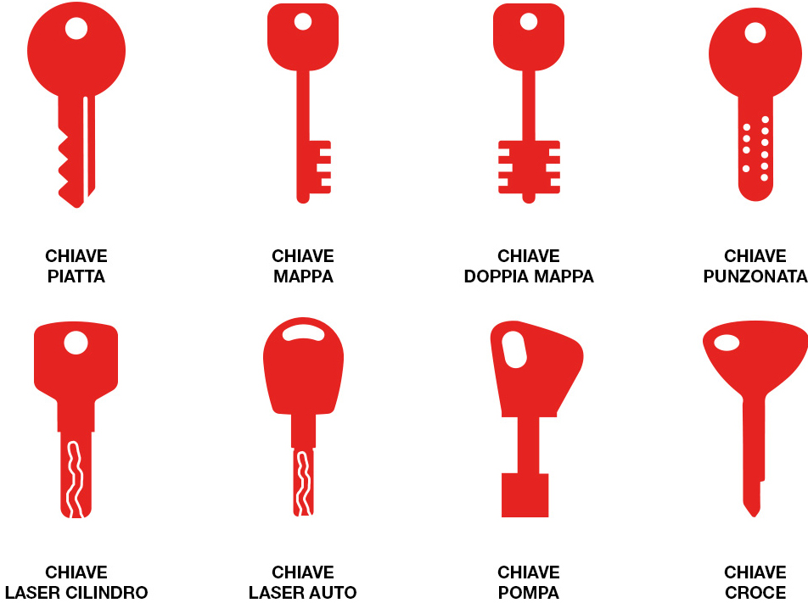



Asymmetric encryption
Create public (red) and private (blue) key
Hand in public key to users
Encrypt the message with the public key
Send message through unsafe channel
Decode the message using the private key
plaintext
ciphertext
plaintext
ciphertext

Slide 14
Other uses of asymmetric cryptography
Asymmetric encryption was created to encode a document with the public key K, send the encoding on an insecure channel, and regenerate the original document with the private key H
But it’s also possible to encode a document with the private key H, and decode it with the public key K.
Since only those who generated H can know this key, decoding it with the public key of a known document encoded with H, guarantees that the "signatory" of the document is precisely who knows H

Slide 15
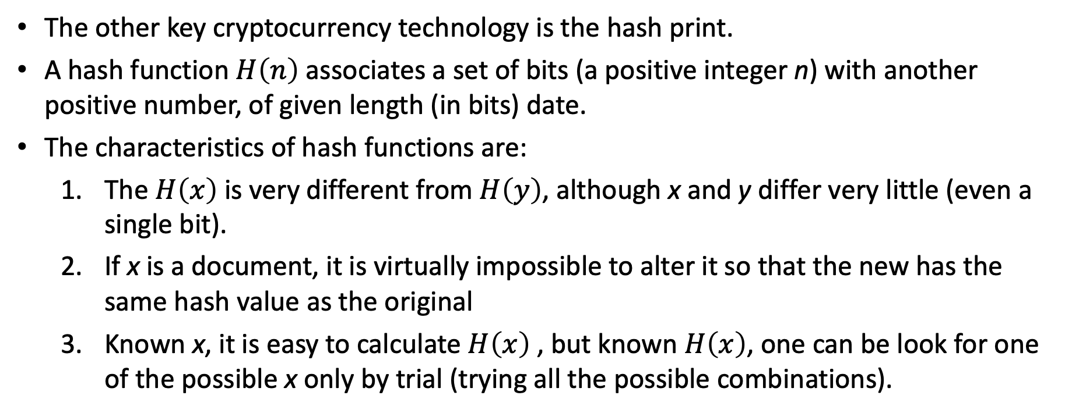
Hash footprints
The other key cryptocurrency technology is the hash print.
A hash function $H\left(n\right)$ associates a set of bits (a positive integer n) with another positive number, of given length (in bits) date.
The characteristics of hash functions are:
The $H\left(x\right)$ is very different from $H\left(y\right)$, although x and y differ very little (even a single bit).
If x is a document, it is virtually impossible to alter it so that the new has the same hash value as the original
Known x, it is easy to calculate $H\left(x\right)$ , but known $H\left(x\right)$, one can be look for one of the possible x only by trial (trying all the possible combinations).

Slide 16
Example of hash prints
echo ELLIPTICAL | sha256sum
0bafaefcd3d968bd632d02ef4e8d74e43a9052811c dc84dac76fde7cfff7ff07
echo ELLITTICAP | sha256sum
ba51d350f4bd38af2091f37f387dd17a892931d4ae 45a5d7ddb8445b11f9e65a
The two strings "ELLIPTICAL" and "ELLIPTICAP" differ by only one bit, the respective hashes are totally different
The algorithm used by Bitcoin is 256-bit SHA-2 (Secure Hash Algorithm 2) standard NIST ( National Institute of Standards and Technology)

Slide 17
Use of hash functions in Bitcoins
The standard hash function SHA2-256 is used for:
Calculating the address from the public key
Certifying that transactions are not altered within a block
Certifying that blocks are not altered within the blockchain
In the blockchain, each block (up to 2 MByte sequence) includes the hash of the previous block
Altering a block would cause it to change the hash, and therefore the hash change for all subsequent blocks!

Slide 18
How easy would be to hack the encryption?
Bitcoin uses 256-bit keys and fingerprints (about 77 decimals)
The only known way to violate them is to try all the possible combinations until you find the right one
In principle, asymmetric cryptography could perhaps be hacked by quantum computers. However:
If it was violated, all Internet applications would have fall into security (passwords, e-banking, digital signature, etc.)
New quantum-resistant algorithms

Slide 19
Violating encryption by trial and error
Let’s say we have a system with 1000 "cores" in every square meter of the world land (150 million km²), each capable of making a thousand billion attempts per second.
The number of computations equal to the age of the earth (about 10 billion years) required to try all the numbers of 77 digits is about 10 followed by 30 zeros!
If we had such a computing system for every star of all known galaxies (a thousand billion galaxies, each with a thousand billion stars), the probability of finding the key in 10 billion years would still be about one in a million!

Slide 20
The digital signature
Modern asymmetric encryption is designed to safely transmit information over computer networks.
Hash functions were created for file management.
The set of two techniques, however, is used to implement digital signature (DS), which:
ensure that the signatory of a digital document (a file) is the owner of the DS;
ensure that the document has not been altered after signature;
prevents the signature from being repudiated by the petitioner.
The DS requires a Central Authority who represents the keeper of the signature

Slide 21
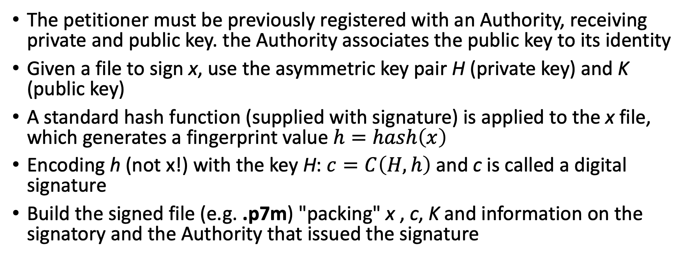
Mechanism of digital signature
The petitioner must be previously registered with an Authority, receiving private and public key. the Authority associates the public key to its identity
Given a file to sign x, use the asymmetric key pair H (private key) and K (public key)
A standard hash function (supplied with signature) is applied to the x file, which generates a fingerprint value $h=hash\left(x\right)$
Encoding h (not x!) with the key H: $c=C\left(H,h\right)$ and c is called a digital signature
Build the signed file (e.g. .p7m) "packing" x , c, K and information on the signatory and the Authority that issued the signature

Slide 22
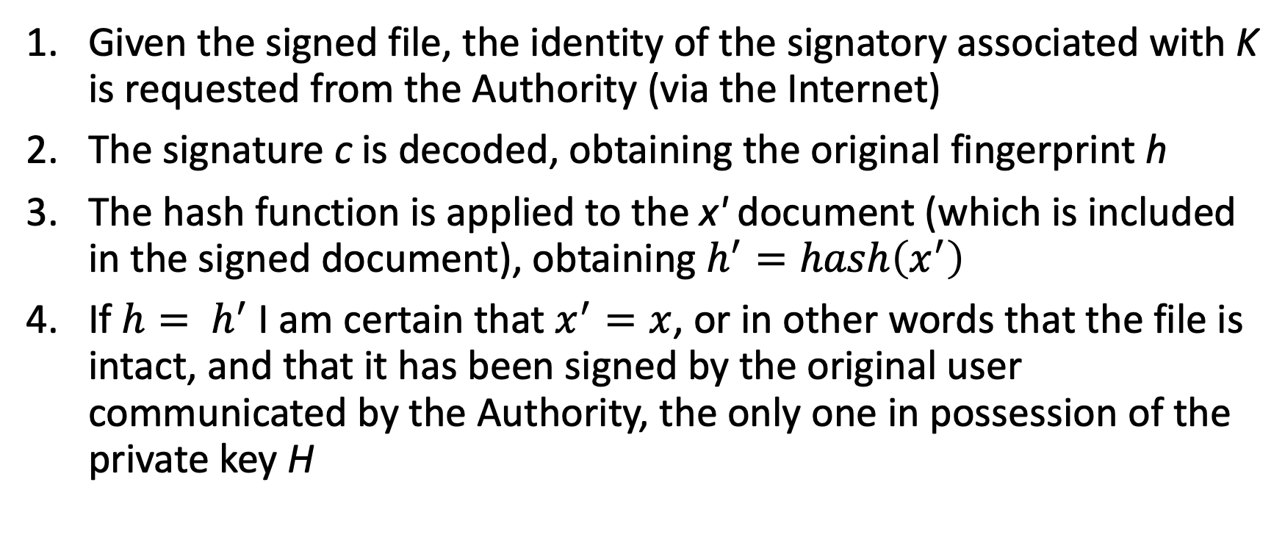
Verification of signed file
Given the signed file, the identity of the signatory associated with K is requested from the Authority (via the Internet)
The signature c is decoded, obtaining the original fingerprint h
The hash function is applied to the x' document (which is included in the signed document), obtaining $h^{′}=hash\left(x^{′}\right)$
If $h= h^{′}$ I am certain that $x^{′}=x$, or in other words that the file is intact, and that it has been signed by the original user communicated by the Authority, the only one in possession of the private key H

Slide 23
The computer bases of cryptocurrencies
Cryptocurrencies can only exist through the Internet:
require real-time transmission of network transactions
require the connection of many hundreds/thousands of nodes containing the transaction validation log (blockchain)
Such nodes are peer-to-peer connected without any centralized control: the network is the cryptocurrency
Open source software developed by a community (or a company) runs on nodes
Notes:
.

Slide 24
The software
The software that allows the network to work is very sophisticated. It contains:
specific data structures for efficient storage and retrieval of information
peer-to-peer network data exchange protocols
the ability to carry out transactions, verifying their consistency with the aforementioned cryptographic techniques
the ability to validate transaction blocks, competing with other network nodes (mining)
the ability to execute a language associated with transactions, the basis for smart contracts

Slide 25
The idea
The currency is like a registration on a public ledger (Block Chain) ,shared on the Internet by thousands of nodes and managed in the P2P fashion
Everyone can connect to this ledger
The software that grant the access to the ledger is open source
Each transaction is shared among the network nodes

Slide 26
Bitcoin address
Each currency transfer has a public receiving address (derived from a public cryptographic key): everyone knows how many BTC (or fractions) have been transferred to a given address
The owner, anonymous, has the associated private key
Only by using this private key you can transfer (only once!) the currency to another public address, irrevocably
This transfer (transaction) is validated and registered in the Block Chain (BC)
Every minute, hundreds of transactions are created and sent to the network, to be validated and entered into the BC

Slide 27
Bitcoin address
In the Bitcoin network, the procedure to generate a new Bitcoin address is:
generates a random number H (private key) of 256 bits
generate public key K from H and standard elliptical curve secp256k1
from K, the Bitcoin address (BTC address) is generated with a complex procedure, described after
the BTC address has about 195 bits, and is represented with 30-34 alphanumeric characters (representation BASE58)
Addresses are recorded in the Blockchain
Given an address, only those who hold the key H can generate K, and from K generate the address A

Slide 28
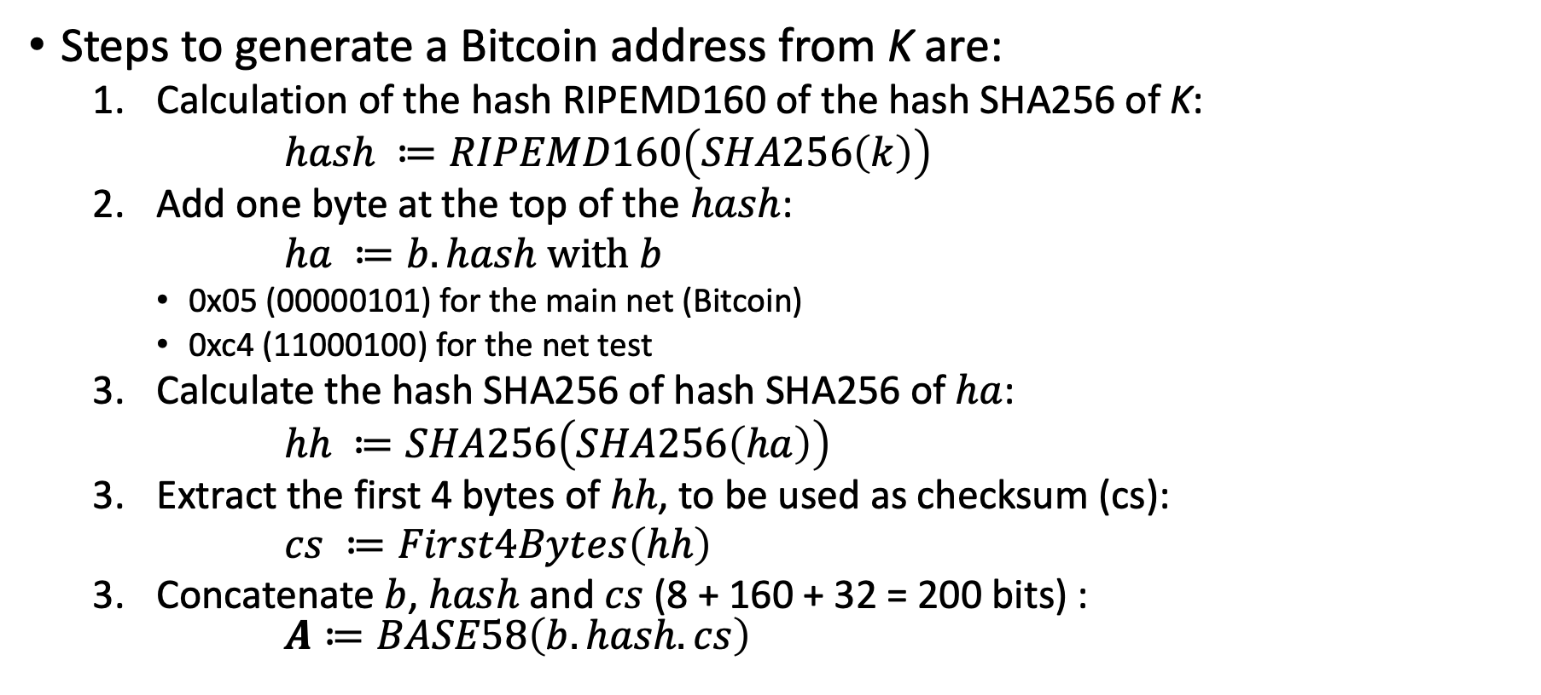
From the public key to the Bitcoin address
Steps to generate a Bitcoin address from K are:
Calculation of the hash RIPEMD160 of the hash SHA256 of K:
$hash ≔RIPEMD160\left(SHA256\left(k\right)\right)$
Add one byte at the top of the $hash$:
$ha ≔b.hash with b$
0x05 (00000101) for the main net (Bitcoin)
0xc4 (11000100) for the net test
Calculate the hash SHA256 of hash SHA256 of $ha$:
$hh ≔SHA256\left(SHA256\left(ha\right)\right)$
Extract the first 4 bytes of $hh$, to be used as checksum (cs):
$cs ≔First4Bytes\left(hh\right)$
Concatenate $b$, $hash$ and $cs$ (8 + 160 + 32 = 200 bits) : $A≔BASE58\left(b.hash.cs\right)$

Slide 29
String BASE58
It is generated by encoding a sequence of bits using the following 58 alphanumeric characters, as digits 0 to 57:
"123456789ABCDEFGHJKLMNPQRSTUVWXYZabcdefghijkmnopqrstuvwxyz”
Missing "ambiguous" characters: "0,O,I,l»
Bitcoin addresses typically start with "1" (which corresponds to zero) or "3" (multisig address, which requires multiple private keys to be unlocked)

Slide 30
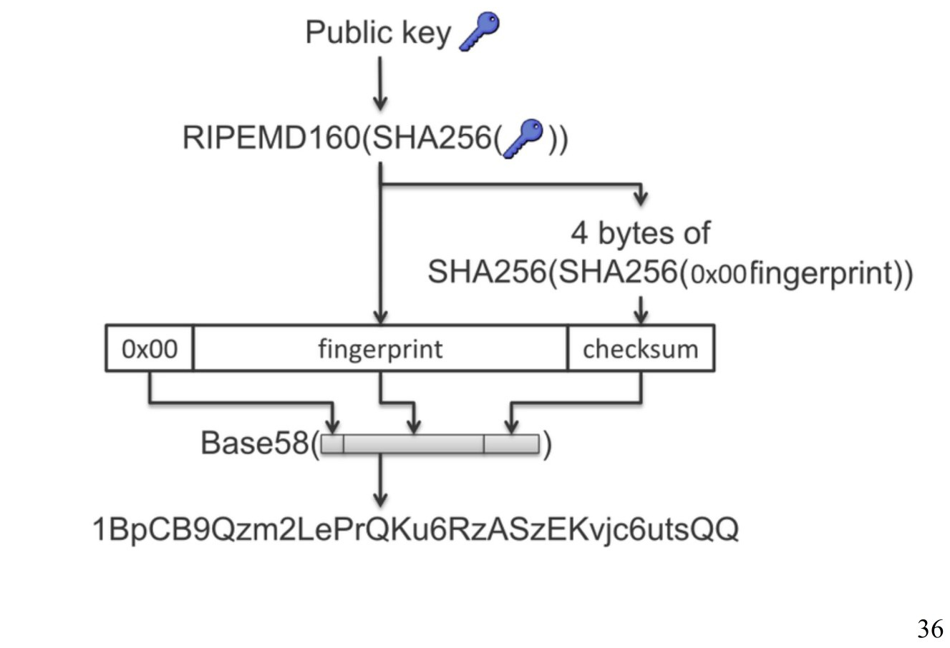
Bitcoin address
Example

Slide 31
Bitcoin address
The "paranoid" procedure of A from K with 4 successive hashing serves to:
prevent the K key from being made public because it could be attached to quantum computers in the future
insert a "checksum" that checks if the address has been typed incorrectly: in this case, the wallet does not make payments to that address
Warning!! - When BTC associated with an address are spent, the public key K is made known in blockchain, and therefore it becomes more vulnerable
For this reason, some recommend changing address at each transaction

Slide 32
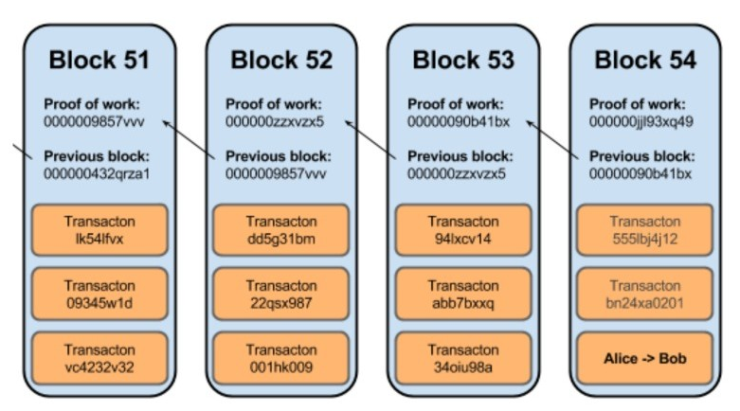
Why it is called Block Chain?
The validated transactions are grouped in blocks (group of transaction, from few to 2000 transactions)
In Bitcoin network, approximately every 10 mins a new block is validated
Each block include the hash of the previous block, and therefore all the blocks are like a chain

Slide 33
The Bitcoin transaction
All requests for money transfer, "signed" through private keys, are sent to the P2P network
Each transaction (money transfer) is verified to be accepted:
The original public address must correspond to existing currency and not already spent (UTXO, Unspent Transaction Output)
The transaction must be signed by the private key corresponding to the address
The destination address must be valid

Slide 34
The problem of consensus
Each node can create and transmit transactions to the node network
Need someone to validate transactions, create new blocks and insert them into the blockchain
Miners do this, competing with each other to solve a cryptographic problem
The first to solve the problem communicates it to the network, which verifies and then accepts the validated block by inserting it in the Blockchain, which is updated in all nodes
Miner receives a reward in BTC
All miners begin to validate a new block
There are mechanisms to resolve conflicts and "collisions"

Slide 35
Peer-to-peer and game theory
One of Bitcoin’s basic ideas is that the system (the network) should be democratic and equal, as well as anonymous
This means that everyone must be able to connect and contribute to the management of the system
The alternative would be an invitation network, with only trusted (trustworthy) entities allowed to participate
There are blockchains of this type, called "Permissioned Blockchain”
The problem is that it cannot be excluded that some of the participants actually have bad intentions:
Trying to make unfair profits (cheating)
Destroy the system, or trust in it

Slide 36
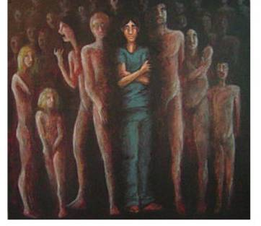
The Sybil attack
If the system allows everyone to connect anonymously, an attacker can run a Sybil attack
Create several entities
Connect each entity to the network and take control of it
The solution for Bitcoin network (and also for others) is to impose a real cost (meaning hardware and energy) to each participant. In this way:
A single entity can support a limited cost
An attack such as the Sybil attack would cost lot of energy,
both in energy and hardware

Slide 37
The Proof-of-Work
The operation of the network in practice is equivalent to the control and recording of transactions
To perform this task it is not enough to check the validity of the transactions sent and gather them in a block
There is the need to demonstrate that the work has been done (Proof-of-Work, Pow)
This is achieved by forcing a complex mathematical problem to be solved:
Find a hash of the block of transactions to be validated below a given threshold
The threshold is configurable so that the calculation time to validate a block is high (about 10' in BTC)
This requires dedicated hardware and electricity

Slide 38
Proof-of-Work and Miner
Miners validate transactions in the BTC network
Their work is rewarded by the creation of new bitcoins, which go to wallet of the first miner that validates a block
Just by controlling 51% of the nodes you could alter the verification of transactions, so a Sybil Attack would be too expensive for anyone
Alternatives to BTC PoW:
PoW requires memory in addition to hash-power
Proof-of-Stake (PoS): the probability of validating a block is proportional to the BTC given as warranty by the miner
Invitation network (permissioned): only trusted entities are invited and a majority vote is held on transactions

Slide 39
The compensation of miners
The first miner to validate the current block, inserts it into the blockchain and earns a fixed amount of cryptocurrency, which is halved every four years (the last one was in May 2020).
All nodes accept the validated block, stop computing on it, and move to the next block
This solves three problems:
The Sybil attack
The remuneration of mining
The gradual introduction of a new currency

Slide 40
Consensus mechanism
In a P2P network the mechanisms of consensus between nodes have the following characteristics:
Failure resistance: This feature is derived directly from the P2P approach
Resistance to external attacks: it is more difficult and more expensive to attack a network of many nodes than a system with a single point of attack
Resistance to collusion: systems with few actors can collude more easily than P2P systems with many nodes, which are unknown

Slide 41
Consensus mechanism
There are several possible ways to arrive at a consensus between nodes, regarding which information block to enter in the BC:
Proof of Work (Bitcoin: SHA-256)
Proof of Work (Ethereum, Litecoin, ...)
Proof of Stake
Proof of Burn
Byzantine fault tolerant (PBFT)
Federated Byzantine Agreement (FBA)
Proof of Authority (Aura - Authority Round)

Slide 42
Consensus mechanism
The consensus mechanism should be characterised by:
Agreement Seeking: All honest participants must agree on the solution.
Collaborative: all participants work together on the outcome, placing the interest of the group before the individual interest.
Equality: all votes have the same weight.
Inclusive: As many participants as possible must be involved in the process.
Participation: everyone who intends to participate must be able to participate in the process of reaching consensus

Slide 43
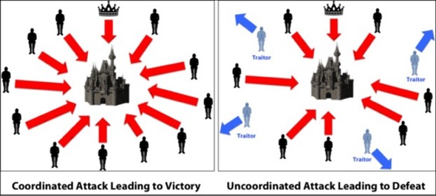
Consensus mechanism

Slide 44
The problem of Byzantine generals
The votes of the generals are transmitted by messengers, to find agreement on when to attack
Some betrayers generals send opportunistic messages, and try to replace the messengers, so that no agreement is reached
or, better, so that some generals believe that the decision is to attack on a given day, and others that it is on another day, to cause a partial attack, and thus defeat
In computer science, the problem was first posed in 1982, to model the consensus of a set of computers in a network subject to unpredictable failures (which are equivalent to "betrayals")

Slide 45
Consensus in Blockchain
In a blockchain, nodes must find consensus on which transactions to approve and/or which blocks to accept
Each node sends messages to the other nodes on a P2P network
”betrayers" nodes may exist that seek to alter the acceptance of transactions, to send false messages or to block incoming messages
Attention, however:
no one can still spend money not his own, if he does not know the private key associated with the address with money
The attack may concern only:
or double spending of money owned by the attacker
or the destruction of trust in the network

Slide 46
PoW
PoW leads to consensus by means of a race between nodes that are meant to solve an expensive cryptographic problem:
The first to solve the problem validate the block
Attacking the network would cost too much (51% attack)
Bitcoin PoW is based only on the calculation of the SHA-256 algorithm:
This has led to the development of specialised Asics
In practice, only large pools of miners can "undermine"
Litecoin (Scrypt) and Ethereum (Ethash) PoWs also require large amounts of memory, so the best hardware is GPUs: anyone can become miner

Slide 47
Proof-of-Stake (PoS)
In the PoS the entire mining process becomes virtual, and the miners become "validators"
Validators pledge some of their currencies.
Then they begin to validate the blocks: when they discover a block they think can be added to the blockchain, they validate it by placing a bet on it.
If the block is accepted, the validators will receive as reward the "fees" of the block transactions.
Otherwise, they lose the pledge.
In the PoS the richest participants in cryptocurrency are more likely to be chosen as validators
on the other hand, they are the ones who have the most to lose from an attack on the blockchain

Slide 48
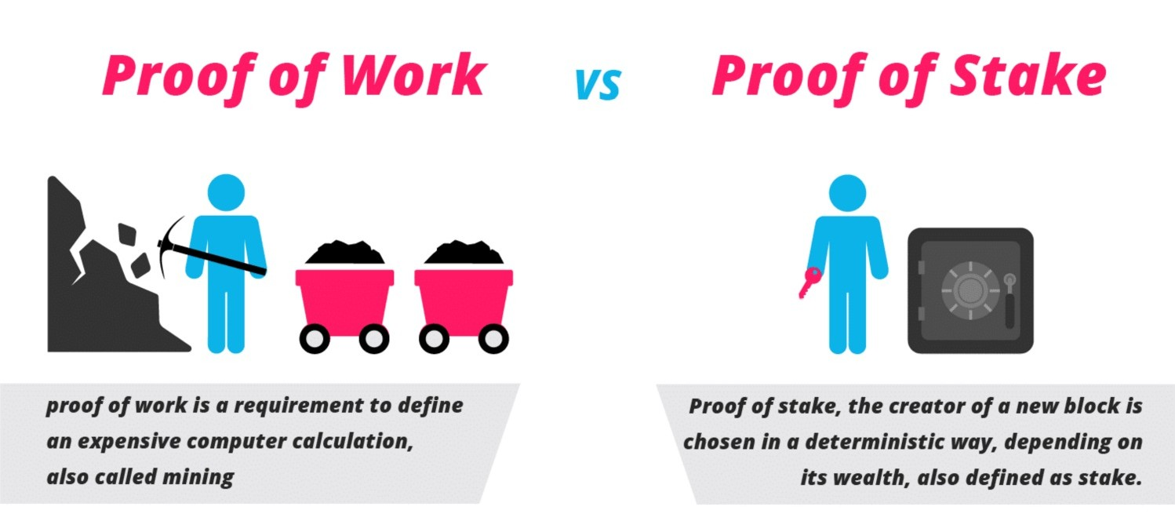
PoW vs PoS

Slide 49
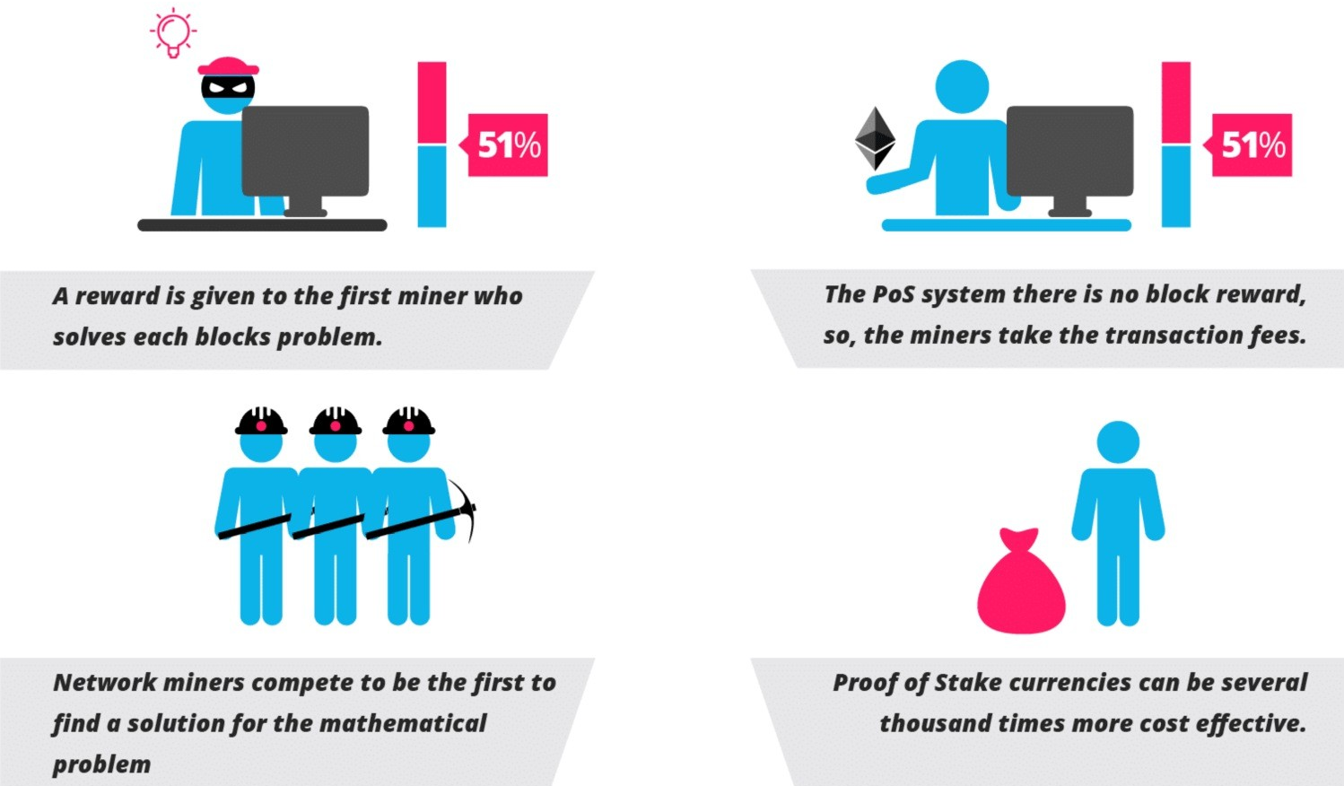
PoW vs PoS

Slide 50
PoS
In the PoS the validators' fees are transaction fees: there is no cryptocurrency creation
The speed of the consensus mechanism is much greater than in the case of PoW: even a few fractions of a second
Two problems:
Blockchain can grow much faster and become less manageable for most nodes
Keeping sequences of "hidden" nodes and then trying to validate a longer blockchain, invalidating already valid blocks is a strategy that would cost little, in the absence of PoW (Nothing at Stake)

Slide 51
Proof of Burn (PoB)
In the PoB, the miners "burn" the coins (sending them to addresses formally OK, but fake), to get the right to validate blocks
The resource consumed is not energy, but the cryptocurrency itself
Block validation has a reward, so miners lose money, in exchange for the prospect of regaining more in medium to long term
The "mining right" decays over time
An attacker (51%) should lose a lot of money (more than all other miners) at current prices, in exchange for an attack that would lead to a devaluation

Slide 52
"Byzantine-resistant" algorithms
These are algorithms that weigh the decisions of nodes, protecting themselves from malevolent nodes ("traitors")
Used in permissioned blockchain
Suitable for "voting" on individual transactions, not on blocks that differ slightly
Require less than 1/3 of the nodes to be "traitor"
Algorithm "Practical Byzantine Fault Tolerance" (PBFT) algorithm by Castro and Liskov (1999)
Algorithm "Federated Byzantine Agreement" (FBA) used by Stellar (XLM)

Slide 53
Bitcoin
Below, we will use Bitcoins to explain how a cryptocurrency works.
Each transaction has a hash that uniquely identifies it
A transaction has one or more inputs, and one or more outputs (see below for exceptions)
In input there are outputs of past non-advanced transactions (UTXO, Unspent Transaction Output):
each input contains an address, the hash (id) of the transaction that transferred the BTC to the address, and the amount transferred in that transaction.
In output there are one or more addresses, with the amount (in Satoshi) to transfer for each address

Slide 54
Commission and irrevocability
The difference between output and input goes to the miner which validates the block as "commission" (fee)
If the miners' commission is zero, or too low, the transaction, even though valid, may not be accepted, or its validation is delayed as much as possible (or at least whenever one kindly miner decide to mine our transaction).
Transactions, once entered into the BC, are irrevocable
Bitcoin protocol provides no way to cancel a registered transaction

Slide 55
Validation of the transaction
For a transaction to be valid, you must:
All its inputs must be "signed" by private keys associated with addresses.
None of the inputs must have already appeared as inputs in another transaction (no double spending)
Output addresses must be valid.
The sum of the input amounts must be greater than or equal to the output amounts.

Slide 56
The "rest" (change)
The inputs of a transaction are outputs not already spent (UTXO) of a previous transaction
These inputs must all be 100% spent within the transaction
If you want to transfer only part of the input in output, you need to add an output that transfers the "rest" (change) to an address owned by the person making the transaction
Such an address may be that (or one of those) of input, but usually you generate a new address, for security and privacy reasons

Slide 57
Generation Transaction or Coinbase
In each block, the first transaction (called Generation, but often called "Coinbase" itself) has a "dummy" input, called "Coinbase".
It has as an output the address of the miner that validated the block - It is therefore a transaction entered by the miner himself
The Coinbase transfers to the output a fixed amount of BTC as a ”reward" for validation, plus commissions (fees) from block transactions
This fixed amount, initially 50 BTC, is halved every 4 years. From 9 July 2016 is 12.5 BTC, in May 2020 was decreased to 6.25 BTC

Slide 58
Other Transactions
Bitcoin protocol also provides for more complex transactions more simple than BTC transfer
Such transactions allow the execution of scripts whose success is linked to the validation of the entire transaction
A multi-sig transaction, for example, must be "signed" by multiple private keys
The simplest transaction is the OP_RETURN
It has no output, and sends all BTC in input to the miner
It is used to record information within the transaction itself

Slide 59
Double Spending
The most obvious form of attack to any digital money system is the “Double Spending”
In BTC, this is an attempt to spend two or more times the output of a transaction, “multiplying” thus their BTC
Protocol protects against attack by considering only the first transaction that expends the output and is recorded in the BC by a valid miner
Thus, the problem is solved in a decentralised way, without the need for a central authority to decide which transaction is valid

Slide 60
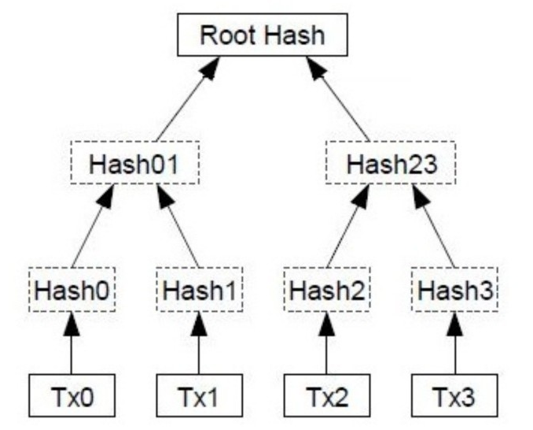
Block data
A block header contains the following data:
Date and time
Number of transactions
Nonce (a 32-bit integer)
Hash of the block
Hash from previous block
Merkle tree hash containing transactions
Other than the block header there is the list of all block transactions contained in the Merkle tree (data structure efficient to verify by hash that transactions have not been altered)

Slide 61
How to validate a block?
A block is validated by solving the computational problem of finding a hash (SHA2-256) of the header that starts with a given number of zeros
The hash varied by varying the nonce and, if not enough, by varying other data such as date-time, Coinbase, Merkle tree
The first miner that finds a valid block notifies the network, accepts it and starts validating the next block
The difficulty of the problem (no. of initial hash zeros) has changed by the system as a function of the total hashing power of the network
The goal is to have about one validation every 10 mins

Slide 62
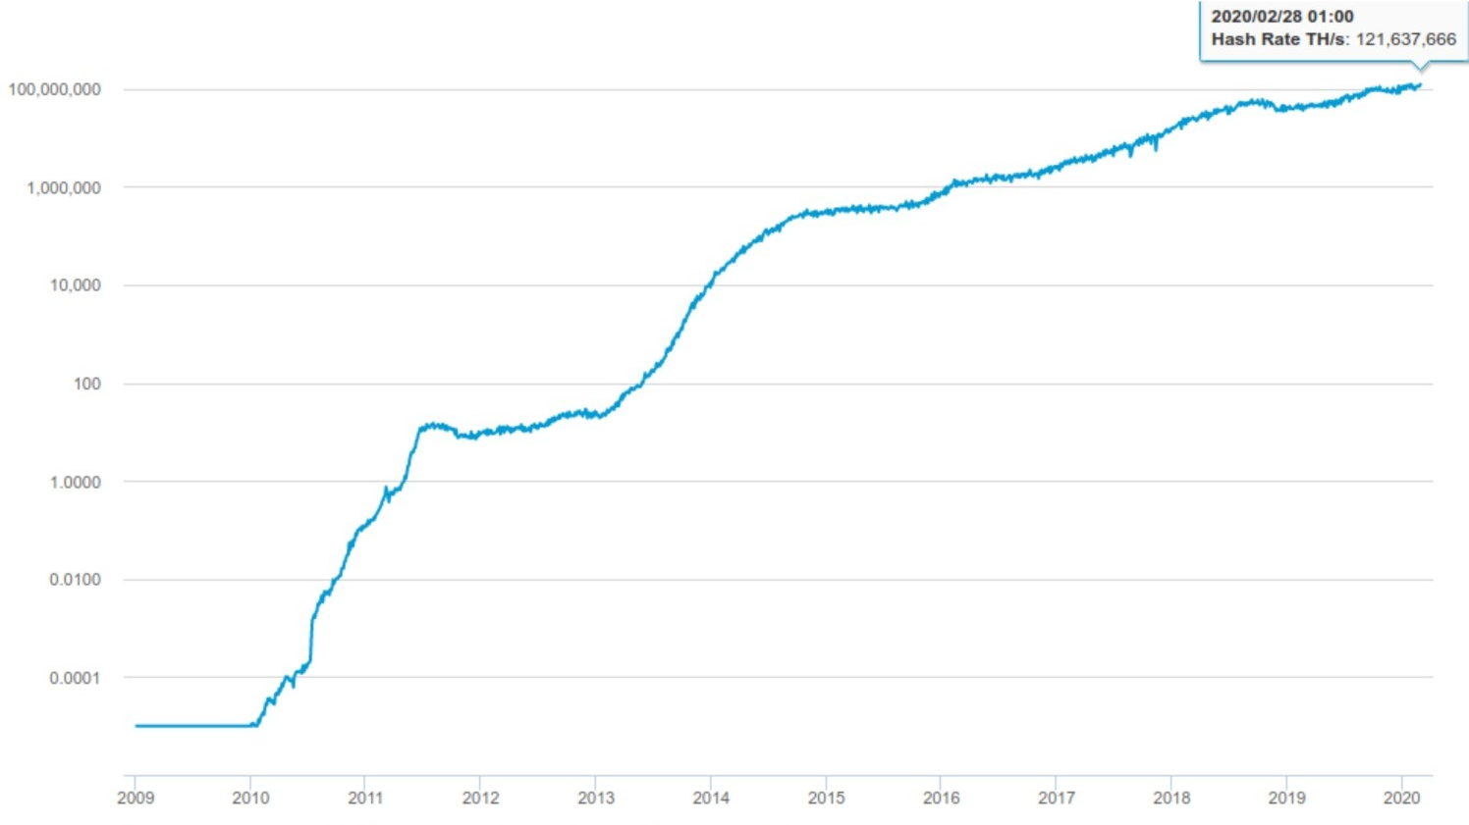
Hash rate
T Hash/s
year

Slide 63
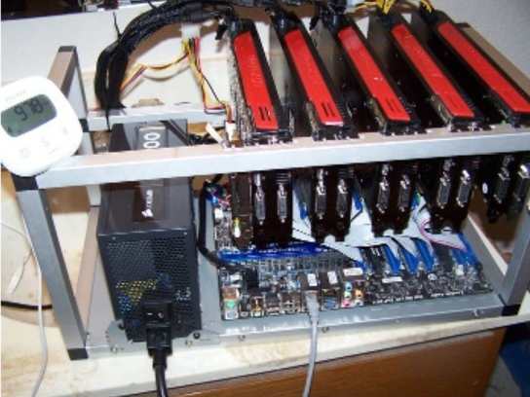
Miners hardware
At the beginning were adopted the laptop of the first participants
BTC did not have value
Hash power: 1 MHash/s
Consumption: 4 kW/(GHash/s)
From 2010 to 2011, came the GPU optimised for hashing
Hash power: 1.5-2 MHash/s
Consumption: 500 W/(GHash/s)

Slide 64
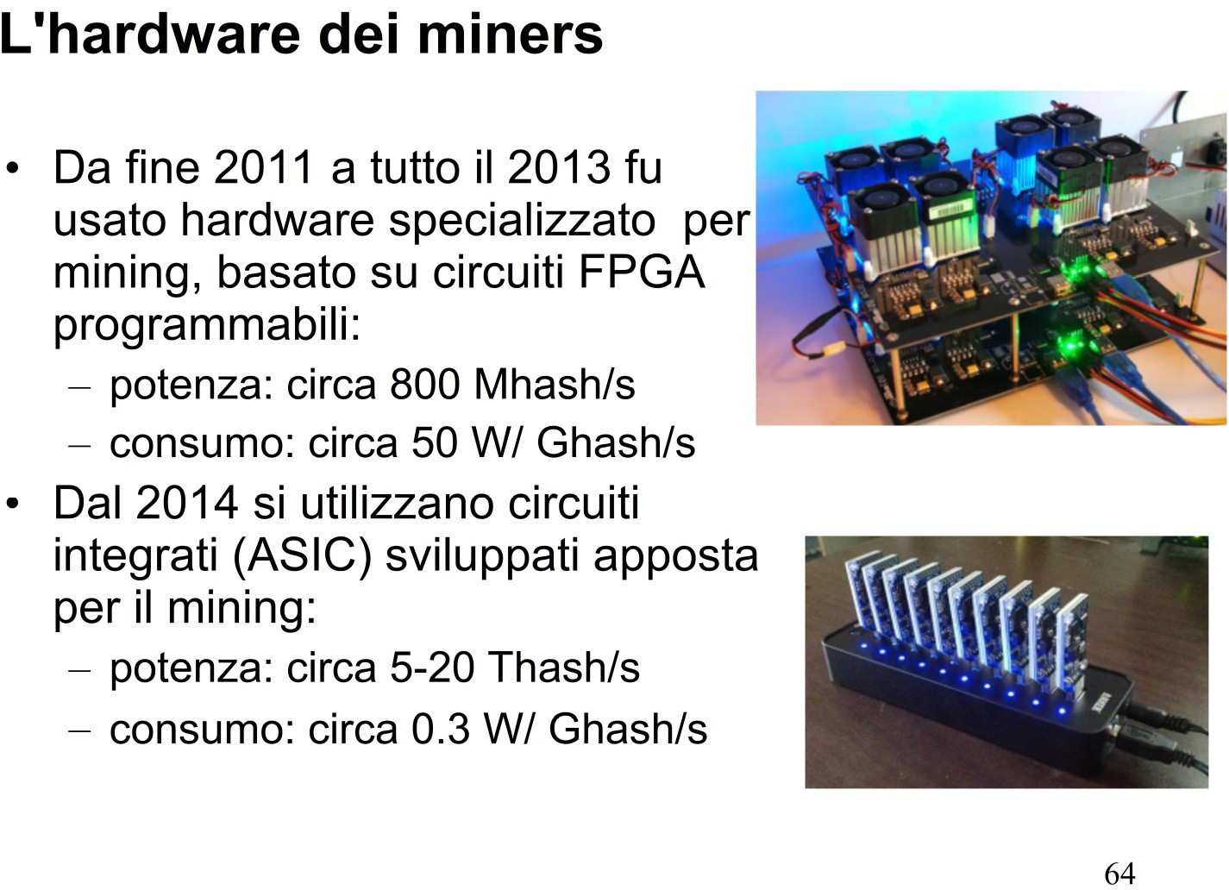
Miners hardware
From 2012 to the end of 2013, the most adopted hardware was the programmable FPGA
Hash power: 800 MHash/s
Consumption: 500 W/(GHash/s)
From 2014, the miners hardware are the embedded circuit (ASIC) developed specifically for mining:
Hash power: 5-20 THash/s
Consumption: 0.3 W/(GHash/s)

Slide 65
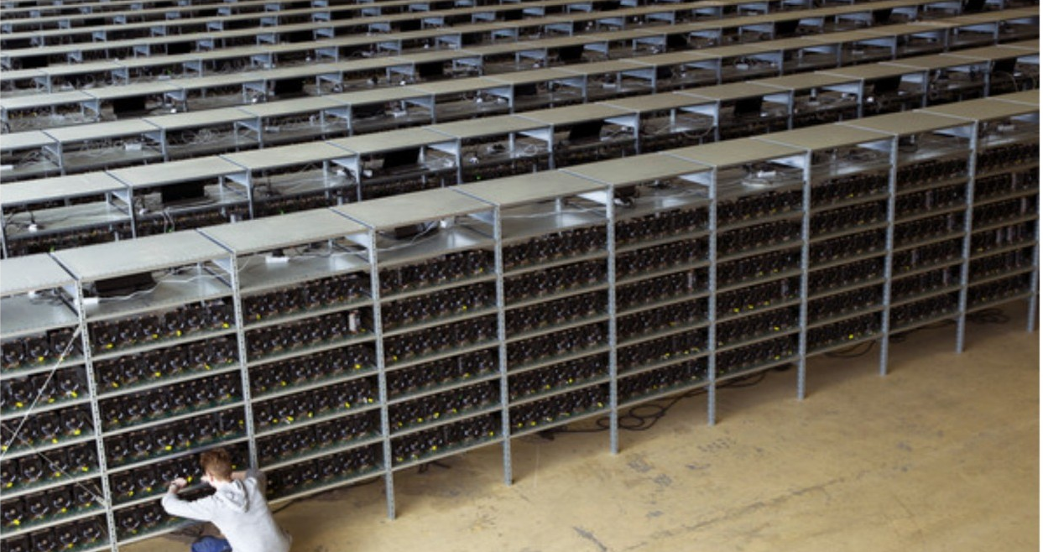
Modern mining farm

Slide 66
Mining Pools
In practice, (almost) no miner operates alone
Miners have been gathering in "pool" for several years to pool resources and optimize mining
A pool organizes the work of the contributed hardware, so that the required hash search is carried out by all in parallel, without duplication
Currently, there are about twenty main pools
The six largest validate about 60% of blocks
The first two (Poolin and F2pool at 03/2020) validate about 44% of blocks

Slide 67
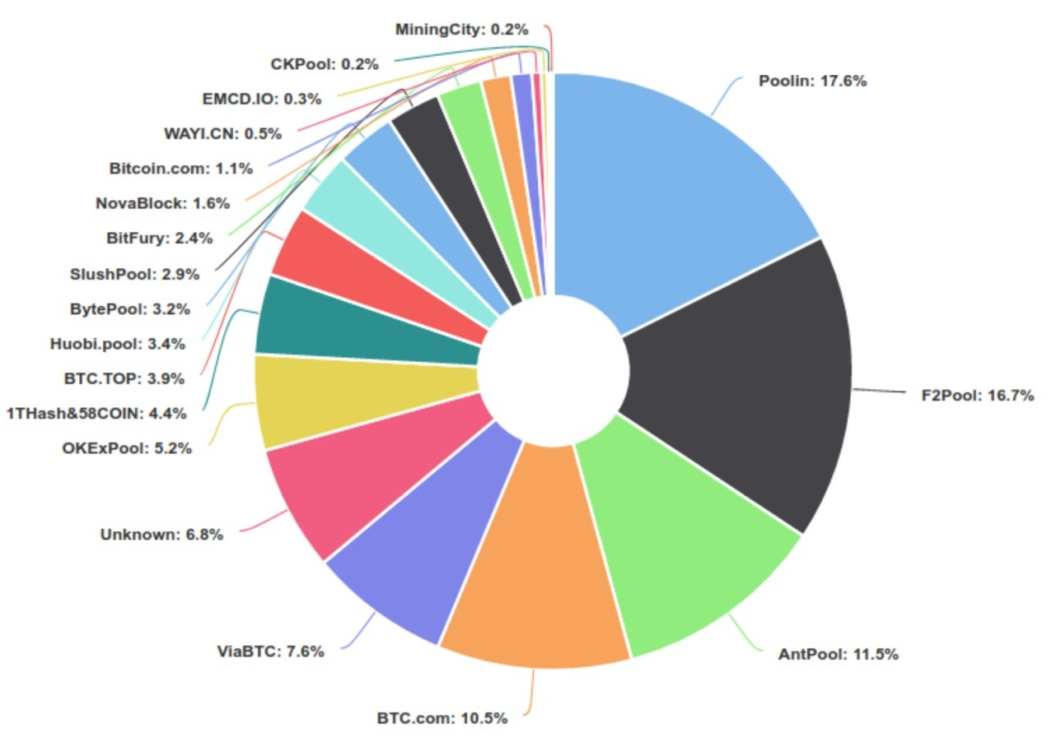
% of blocks validated by pools at 03/2020

Slide 68
Sending transactions to blocks
Transactions sent to the Bitcoin network for validation are called "unconfirmed transactions”
If a transaction is entered in a block that is validated, it becomes "confirmed”
Nodes maintain a list of unconfirmed transactions, called an unconfirmed transactions' memory pool, or mempool
In order to be added to the mempool, a transaction still needs to be validated, and does not need to spend input already spent on a transaction already contained in the mempool
Validated transactions from orphaned blocks (see below) and not in the correct BC are returned to the mempool

Slide 69
Validation of blocks: problems
If a transaction grants a fee that the miners consider too low, it remains in the mempool until it is withdrawn, or until some miner inserts it into a block that is then validated
Currently, the blocks have a max. size of 1MB, so they can contain at most about 2000 transactions. The net in 2016 has practically reached the limit of 3-4 transactions per second
Rarely, two miners can validate a block almost simultaneously, communicating it to the network
In this case, one part of the miners accepts the first block and one part the second...

Slide 70
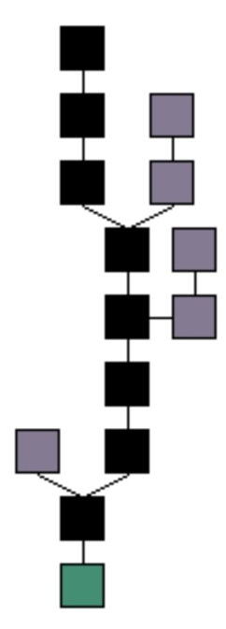
Fork
When two miners validate their block in near real-time, there is a blockchain fork
Some miners will accept the first block whilst the second the other one.
However, after few times, all the miner will accept the chain of blocks that has the longest chain, abandoning the shortest chain and generating orphan blocks.
In figure the true blockchain is in black while the grey block represent the orphaned blocks. In green the Genesis Block (the very first block)

Slide 71
Fork
In case of double validation, the two competing blocks will contain almost the same transactions
There is a strong likelihood that, in the two competing branches, the next two blocks are not yet validated almost simultaneously
In this case, one of the two branches becomes longer than a block, and the miners choose the chain that contains it
Otherwise, the two branches lengthen together, until one becomes longer than the other
The mechanism is robust and prove its effectiveness
BC, anyway, includes orphaned blocks, which are ignored in transaction validation

Slide 72
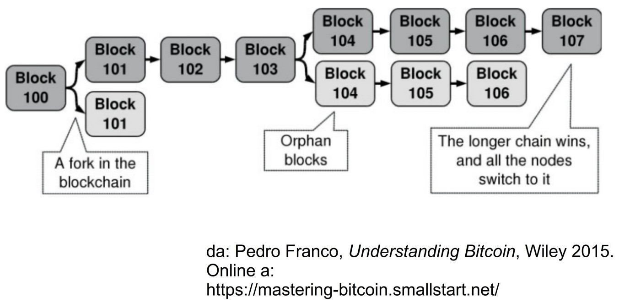
Fork

Slide 73
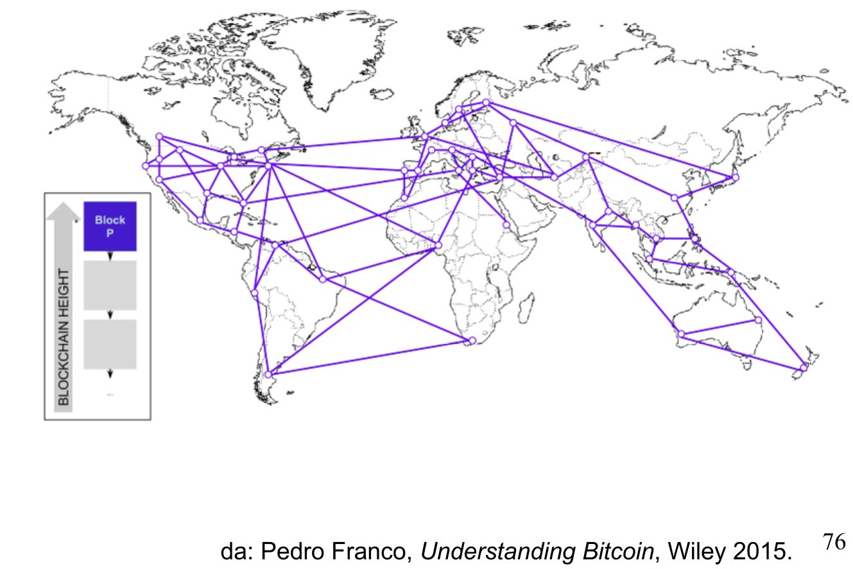
Fork

Slide 74
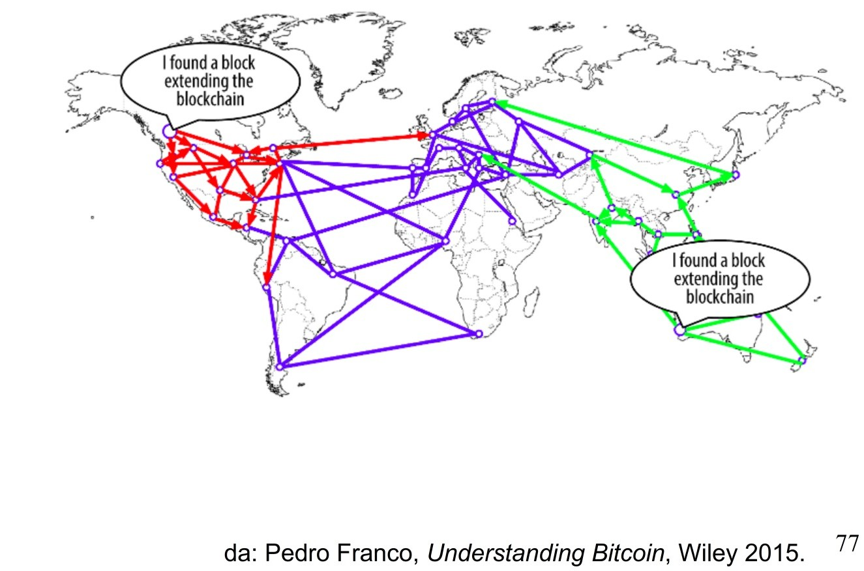
Fork

Slide 75
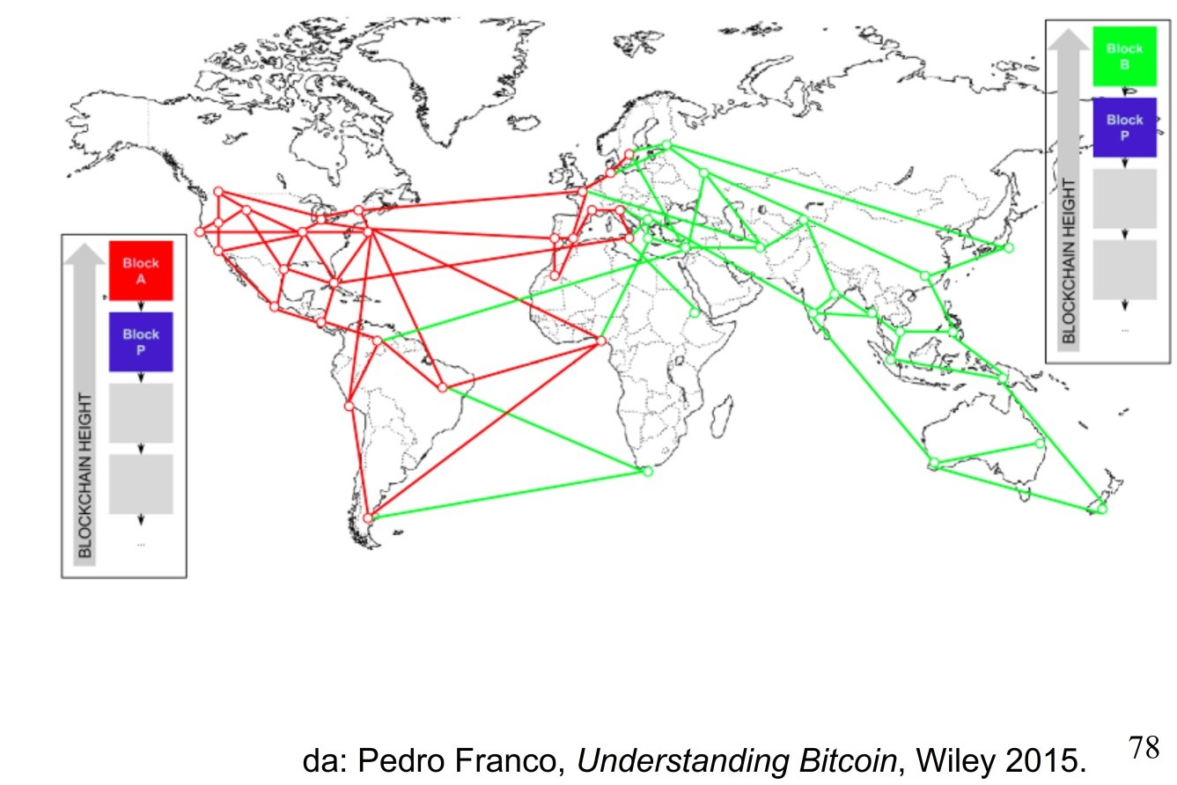
Fork

Slide 76
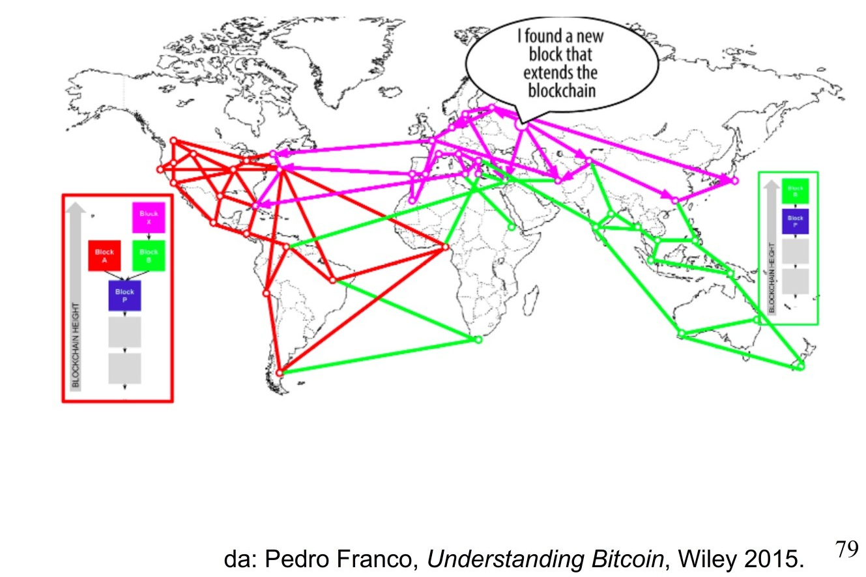
Fork

Slide 77
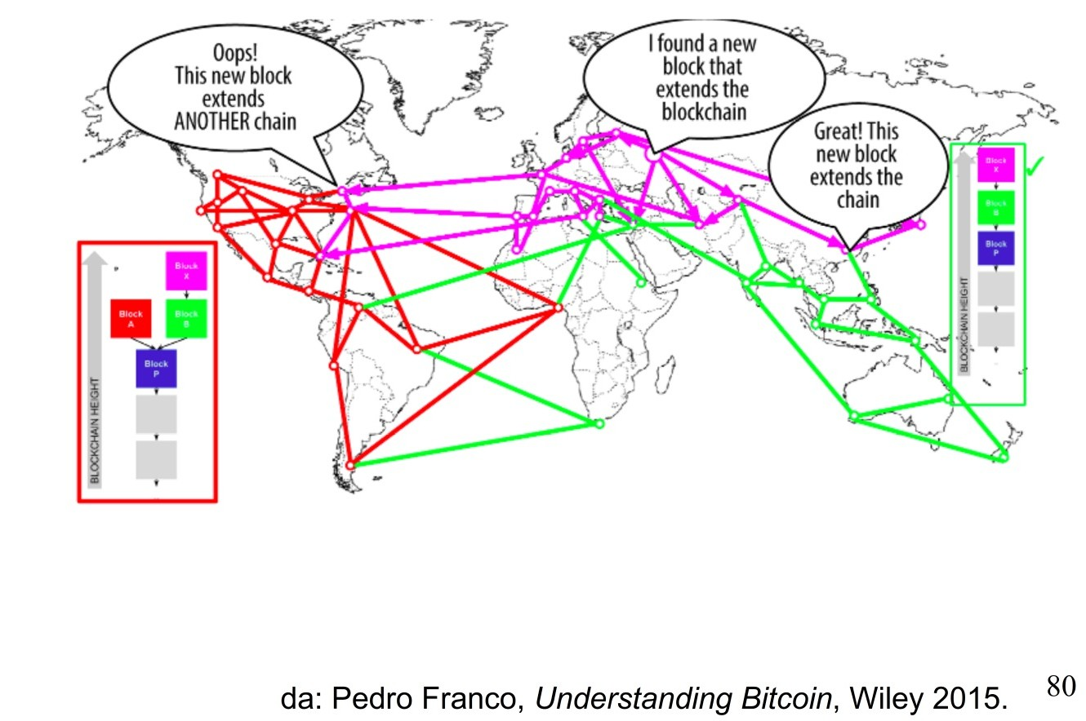
Fork

Slide 78
Where do we keep cryptocurrencies?
In wallets in our computer or mobile terminal
These are programs that retain public and private keys, and are able to access the BC and make/receive payments
in current accounts with Exchanges. Exchanges are companies that allow the buying and selling of cryptocurrencies. They act through web portals.
In the bank vault:
Public and private keys printed on paper, using codes readable electronically, and plasticised

Slide 79
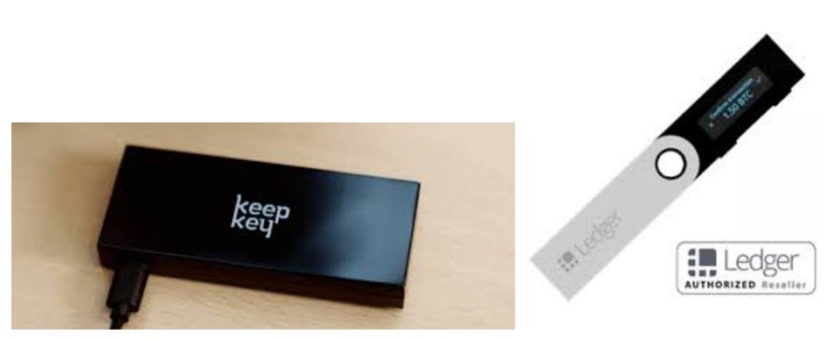
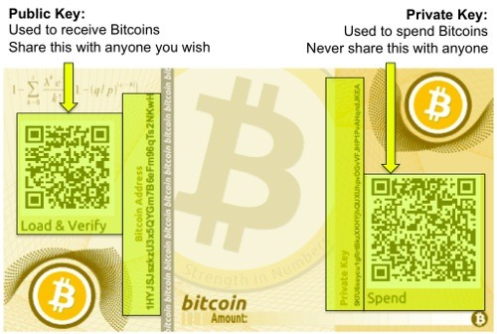
Wallet

Slide 80
Attacks to Bitcoin
Since the beginning, the Bitcoin network and its entire value chain (mining, Wallets,...) have been the subject of cyber attacks
This perhaps also because of the fact that, at least in the beginning, Bitcoin was a "game" for cryptographic experts
Below are some of the main attacks, theoretical or really carried, to the Bitcoin network, to miners and Wallets

Slide 81
The attack of 51%
This is the most famous of the attacks that could theoretically be made to the Bitcoin network and its BC
Planned from the beginning by Satoshi Nakamoto
It is relatively simple. If a single miner controlled at least 51% of the hashing power of the network could alter block transactions by double spending for its own and force verification by its own computing power
Mining pools may reach 51% of the hash power of the network
It is believed to be a theoretical attack, because its occurrence would lose confidence in the BTC, causing its value to fall and thwarting the attacker’s efforts

Slide 82
Race Attack
It is an attack that exploits the delays in the propagation of transactions in the network
When a node receives a transaction to be confirmed, it inserts it into a "cache" and discards any other transactions that seek to spend outputs again
By sending two double spending transactions to different groups of nodes, close to the two respective receivers, for some time each receiver can see their transaction considered valid in the neighbouring nodes, and release the goods/services given in exchange
In practice, before accepting a transaction, it shall be checked that it is included in the BC, and that at least 4 to 5 blocks are verified after that of the transaction
This eliminates the chance of Race Attack success

Slide 83
The attack of Finney
Planned by Finney in 2013
It is carried by a miner who secretly validates a block, inserting a transaction from one address to another
Before another (real) block is validated, the miner creates another transaction in double spending
Once the transaction has been accepted, the miner publishes the block which has been secretly validated, effectively invalidating it
Also this attack is ereased waiting to see the transaction in BC, with other blocks validated after
This approach has the disadvantage that a transaction is not considered final before about an hour

Slide 84
Attacks on miners
In literature, many possible miner pool attacks are described: Pool Hopping, Mining Cartel, Selfish Mining, Block Discarding, Block Withholding
They are essentially of two types:
a miner associated with a pool earns his share, but if it finds a valid block it hides it and then collects it on his own account (with all possible variants)
a large group of miners (usually more than 50%) ignore blocks validated by other miners
It seems that 13 June 2014 was actually brought a Block Withholding attack at the Eligius pool, with a declared loss of 300 BTC (180,000 USD at the time)

Slide 85
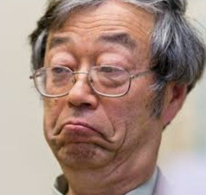
Just for fun: Who is Satoshi Nakamoto?
Satoshi Nakamoto is a real Japanese person, and he is an expert on cryptographic, but he is not involved in Bitcoin
Satoshi Nakamoto (pseudonym) published the “white paper” in 2008 and at the beginning of 2009 started the Bitcoin network
He said to live in Japan and that he is 37 years old
The timestamp of his post on the blog indicates the west coast of USA
He writes a perfect English
There is a strong likelihood that he has done the miner for over one million of BTC, which address are known and all the gathered BTC are still there
The last messages are back to 2010, from when he disappeared

Slide 86
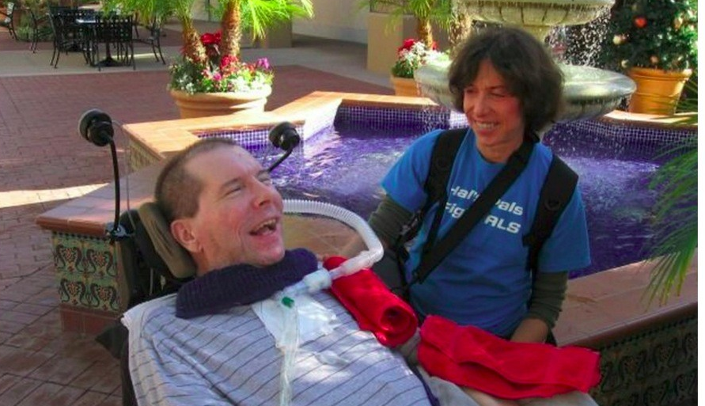
Who is Satoshi Nakamoto?
Hal Finney was an expert of cryptographic
He was involved in Bitcoin project since the beginning. He lived near Satoshi Nakamoto from the previous slide.
His bitcoin address did the first transaction with the Satoshi address
In 2009 was found to be affected by SLA. He died in 2014 and his body were frozen, waiting the world to find the cure for SLA.

Slide 87
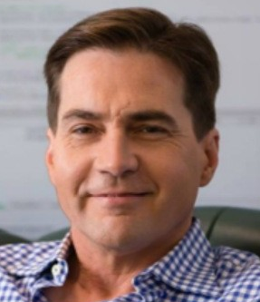
Who is Satoshi Nakamoto?
Craig Steven Wright is an Australian computer scientist
He dealt with Bitcoin since the first years of its birth. He established the W&K Info Defense Research LLC with Dave Kleiman in order to mine bitcoin and to develop software on Bitcoin system
In 2016 he claimed that he was Satoshi Nakamoto, but then he gave up demonstrating (he has never showed a private key of one address which had gained reward from the first miners). He tried to demonstrate showing to the world one private key which, however, was a reused of an old private key showed in 2009
In 2017, with Roger Ver, built an “hard fork” of Bitcoin, the “Bitcoin Cash” (BCH). With this fork unsuccessfully seeks to drop the price of BTC compared to BCH, to make it the "real" Bitcoin
In November 2018 it separated from BCH, creating a new fork "Bitcoin Satoshi Value" (BSV)

Slide 88
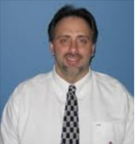
Who is Satoshi Nakamoto?
Dave Kleiman was an expert in computer forensic analysis
He was a friend and co-author of several scientific papers with Craig Steven Wright with which established the W&K Info Defense Research LLC
In 2010 he undergone treatments for staphylococcus
In 2013, he left the hospital for living in alone like a homeless
He died in 2013 near bottles of alcohol and a loaded gun (never used)
He is thought to be Satoshi Nakamoto since:
He was in the "circle" of cryptographers who collaborated on the creation of Bitcoin in the “Metzdowd” cybersecurity mailing list
He was very focused on privacy and security and always kept a high security key
He was hospitalized just as Satoshi Nakamoto disappeared (and could no longer keep the secret)
Wright had no reason to involve Kleiman if Kleiman wasn’t the real Satoshi. Faced with a long research which concluded that Wright was unlikely the author of the ” Bitcoin white paper", he cited Kleiman as an important co-author

Slide 89
Who is Satoshi Nakamoto?
Deductions:
Wright could only claim to be Satoshi if he was absolutely certain that the real Satoshi would not contradict him. He knew David Kleiman was dead.
Kleiman had the right profile and skills to be Satoshi
Wright had initially convinced Gavin Andresen by presenting the miner’s private key to block 9. The real Satoshi Nakamoto must have provided this evidence to Wright, which perhaps had been given to him by Kleiman to prove he was Satoshi. Wright couldn’t provide any more convincing evidence.
Recently, Ira Kleiman, brother of Dave Kleiman, sued Wright for half of Satoshi Nakamoto’s Bitcoins, (supposed to be $5 billion). Ira probably has evidence to support this case. Funny thing: the best defense for Wright would be to say he lied.
Conclusion: The probability that Kleiman was Satoshi Nakamoto is quite high!

Slide 90
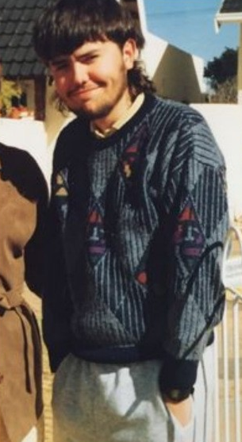
Who is Satoshi Nakamoto?
Paul Solotshi Calder Le Roux was an computer scientist and a criminal
He was interested in programming demonstrating great skills. When he was 16 years old, he illegally sold pornographic video
In 1998 developed the program E4M (Encryption for the Masses), program on which is based the TrueCrypt software (2004). This software manage virtual encrypted disk drive on Windows and Linux
In 2004 built several website and call center for selling therapeutic drug online
In 2007, he was famous on the drug and weapons trade. This business lead him to kill several people that betrayed him
In 2012 he was arrested, and nowadays he is in prison. Seems that Craig Wright requested special protections by Le Roux since Wright thought he could be killed by Le Roux

Slide 91
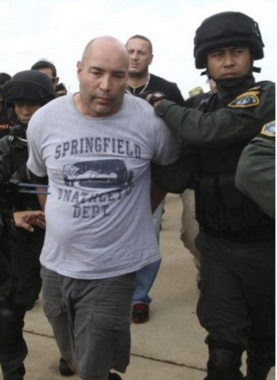
Who is Satoshi Nakamoto?
Deductions and clues:
The curious resemblance: Satoshi / Solotshi
Both C++ programmers
Both with a strong interest in encryption and privacy
Both distrustful of authority
Both interested in online gambling: Bitcoin’s initial code included a poker client
Both aware of the difficulties with traditional payment systems, Le Roux because of its drug racket
Satoshi disappeared in early 2011 to "move on to other things", at a time when Le Roux was moving from software genius to gang leader
With tens of millions of dollars in cash, Le Roux does not need to cash its BTC

Slide 92

Who is Satoshi Nakamoto?
If a writer had created the plot for a crime novel, he could not have done better!

Slide 93
Thank you for your attention!
www.smartgridsmaster.eu

